Slide 1
Week 12 Version Control System
Programming Fundamentals Team Teaching 2023

Slide 2
Learning Outcome
After finishing this topic, students:
Must have a good understanding on version control, including how it works and why it is needed for developing program.
Must be able to understand the fundamentals of kanban, including workflow visualization,work limitation, and continuous improvement.

Slide 3


Introduction
VS
Flashdisk
Repository
A repository allows developers team to work together in a structured manner, track code changes, and manage versions of various project components.

Slide 4
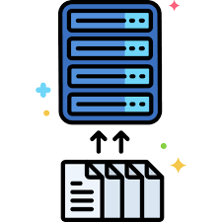
What is Repository?
A repository in a software development is a digital storage that is used to manage source code, configuration files, documents, and other resources related to a project.

Slide 5
The Main Component of the Repository
Source Code: files that contain instructions that will be executed by the computer as a software.
Documents and Configuration Files: it contains documentation files, installation instructions, and configuration files required to run the software.
Issues and Tasks (Issues): it provides a feature to report issues or problems found in the software.
Branch and Merge: it allows developers to work on specific features or fixes without affecting the code in the master branch. When finished, the branch can be merged back into the main branch.
Change History (Commit History): it records every change made to the source code

Slide 6
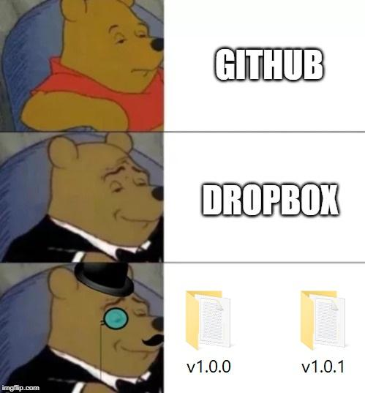
Version Control System (VCS)
Version Control System (VCS) is a system that is used to track changes to source code and other files in a software project.

Slide 7
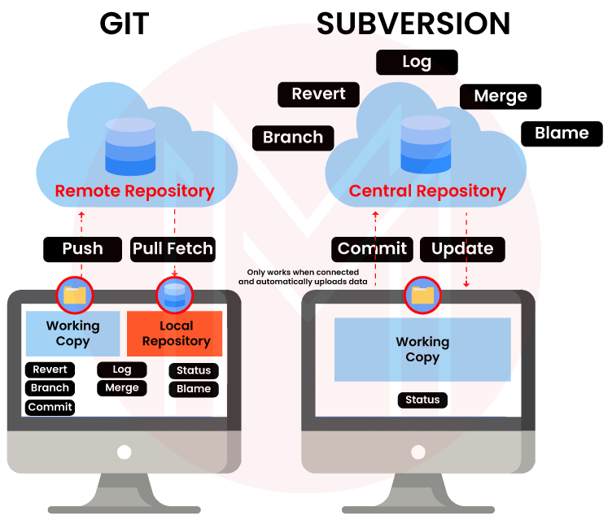



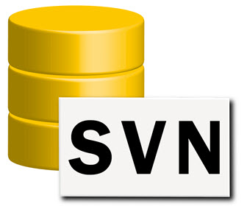
VCS Type
Distributed Version Control System (Distributed VCS): every single member team has a full copy of the repository in their own machine. It means that the versions can be saved in the remote repository as well as in local repositories of the local machines. Example: Git.
Centralized Version Control System (Centralized VCS): a central repository stores all versions of source code and other files. Example: Subversion.

Slide 8
The Benefit of VCS
Change Tracking: it records every change made by developers to the code. It allows developers to view change history as well as to roll back to previous versions if needed.
Team Collaboration: it allows developers team to work on the same code simultaneously, and to safely merge the changes.
Conflict Management: in case there are two or more developers make changes to the same part of the code, VCS helps detect and resolve conflicts that may appear.
Recovery and Troubleshooting: If there is a problem with the latest changes, it allows to easily roll back to a previous working version.
Revisions and Versions: it assigns each version of code a unique number, allowing developers to refer to a specific version.
Software Testing and Testing: it allows to develop in an isolated environment, VCS supports testing and experimentation without affecting the main code.

Slide 9
The Use of GitHub, GitLab, Other Platforms
GitHub and other platforms is VCS provider. Its role is to provide infrastructure to manage Git repository and facilitate developers team to collaborate in software development.
Hosting Repository; a place to store Git repositories online.
Teams Collaboration; it allows development teams to work together in a single repository.
Issues and Tasks Management; it tracks and manages issues, feature requests, and tasks in projects.
Pull Request; it submits code changes for a review by other developers before being merged into the main repository.
CI/CD (Continuous Integration/Continuous Delivery) Integration; it supports testing automation, integration automation and software delivery
Access Settings; it manages permission and access to ensure the right control to the repositories.

Slide 10
The Use of GitHub, GitLab, Other Platforms #2
Project Documentation; provides project documentation and guidance for developers and users.
Code Review; support the code review process with comments, suggestions, and other feedback.
Third Party Integration; has integration with other development tools such as project management tools, issue tracking systems, and planning tools.
Open Source Publications; open source software development by making it easy to share code with the community.
Paid and Free Versions; paid with additional features, while others have free options for open source projects.

Slide 11
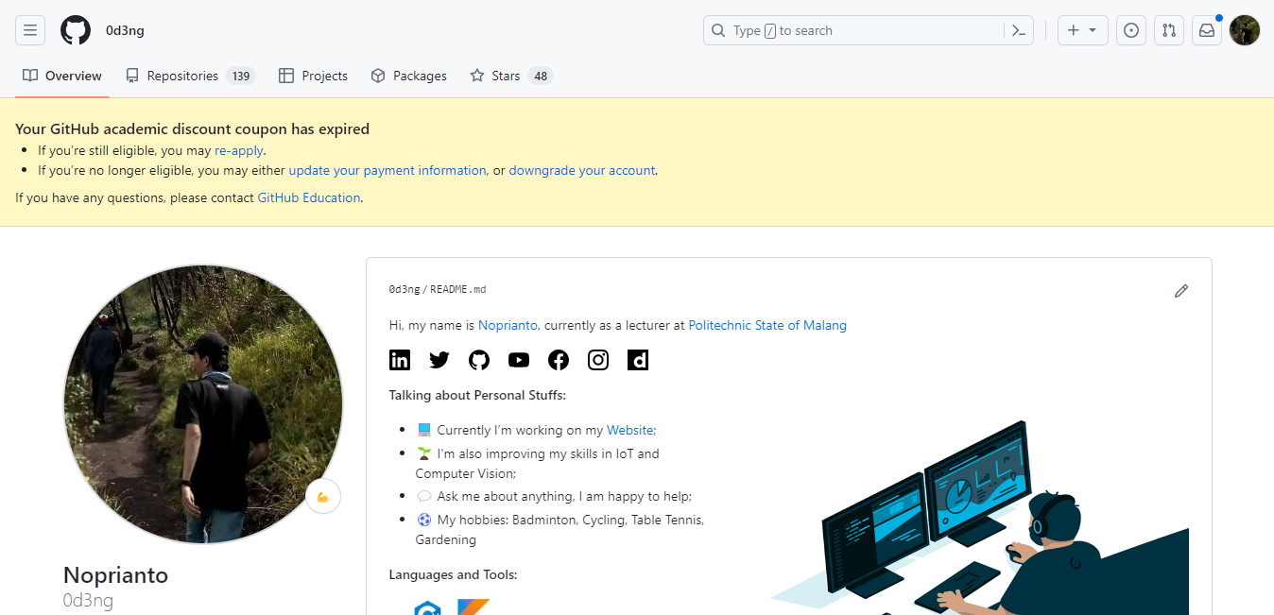
GitHub
GitHub is a web-based repository management platform based on the Git version control system.
One of the most popular and widely used platforms by software developers, both in open-source projects and private projects.

Slide 12
Main Feature of GitHub
Repository; create public or private repositories to store source code, configuration files, documents, and other resources
Git Integration; perform standard Git operations such as commit, branch, merge, and rebase via the web interface or command line
Collaboration; can work together in the same repository
CI/CD Integration; GitHub Actions is a Continuous Integration (CI) and Continuous Deployment (CD) integration tool that integrates directly with the GitHub repository
GitHub Pages; allows users to host static websites directly from GitHub repositories
GitHub Classroom; an educational platform that facilitates teaching and learning Git and GitHub in a classroom environment

Slide 13
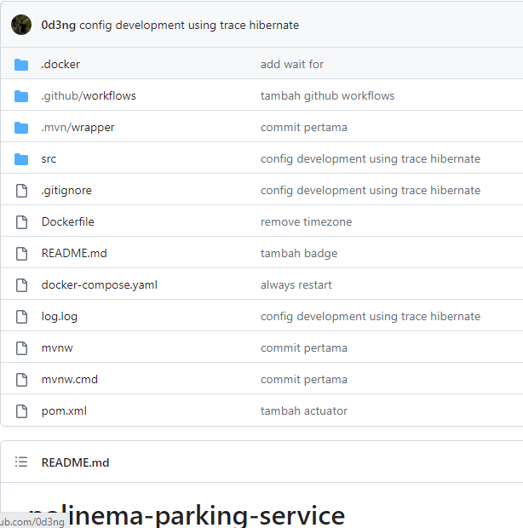
GitHub - Repository
src; folder that is used to store program code.
The other files contain the configuration of a project. For example the pom.xml file is a configuration file to store all dependencies/Libraries when using Maven (build tool).

Slide 14
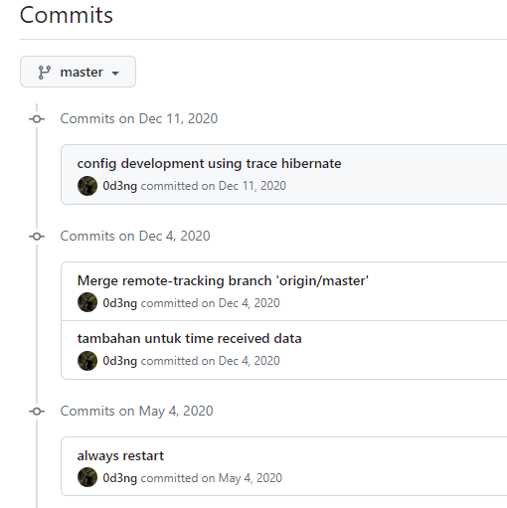
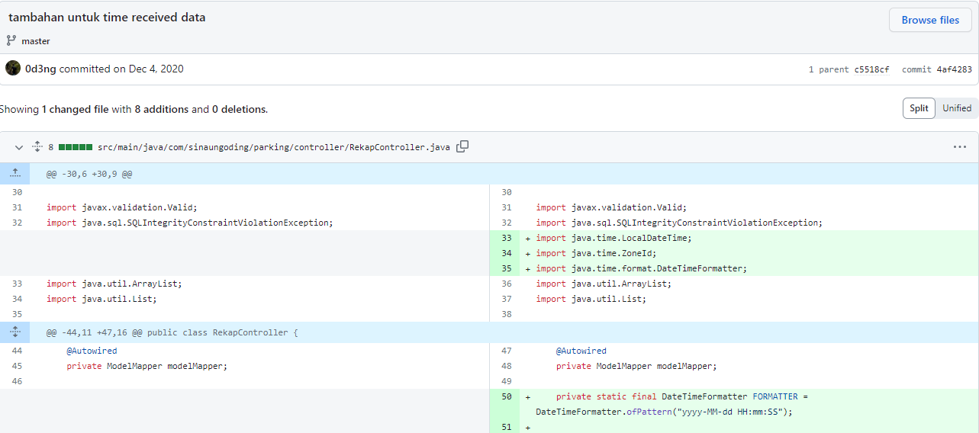
GitHub - Git Integration
Commit is ensuring and recording every addition to program code. Every commit process will be recorded with information about when, who, which.

Slide 15
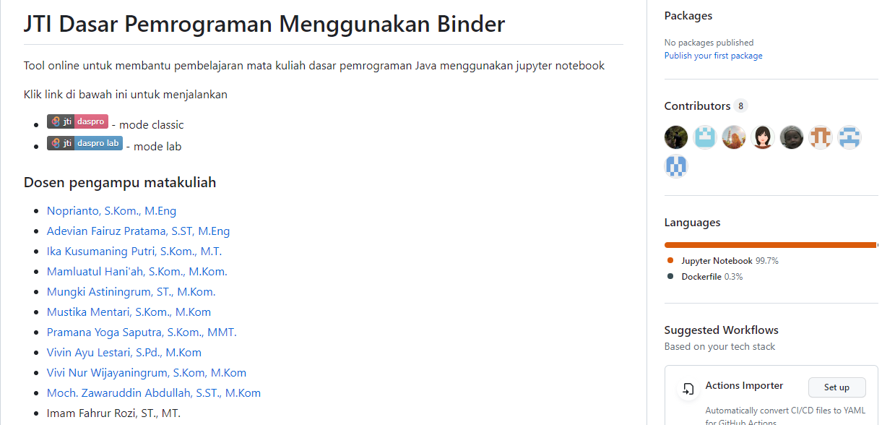
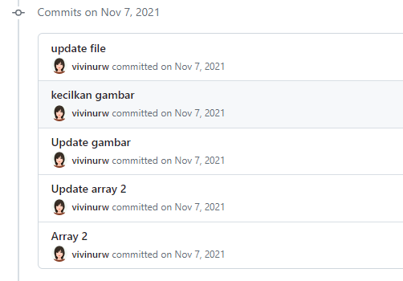
GitHub - Collaboration
Multiple users can contribute to the same project.

Slide 16
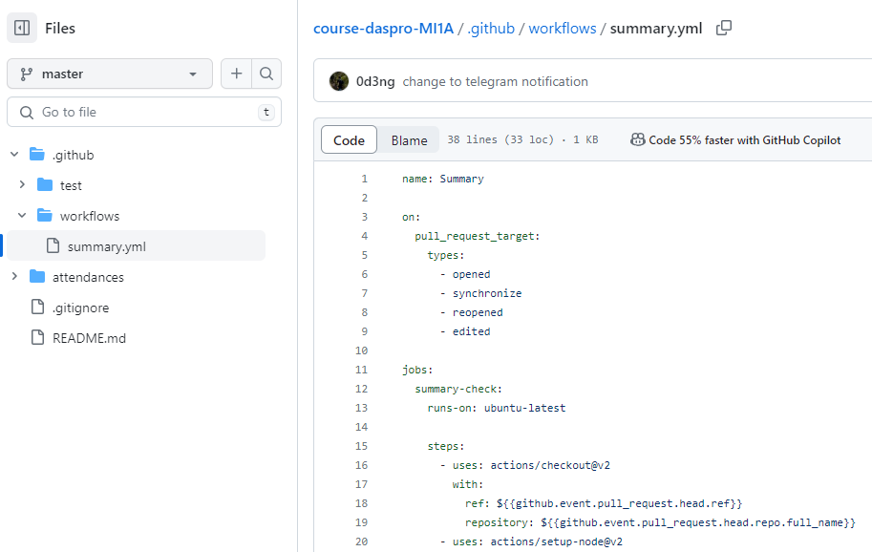
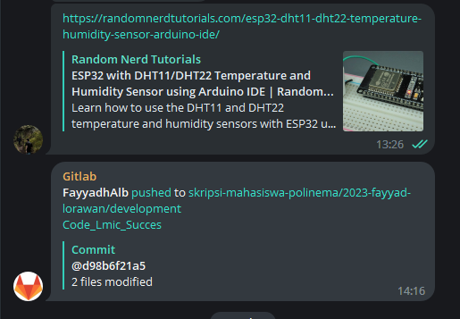
GitHub - CI/CD Integration
An example of using continuous integration is when there is a pull request or something else, it is adjusted to your needs and then merges it into the master, then provides a notification to Telegram.

Slide 17
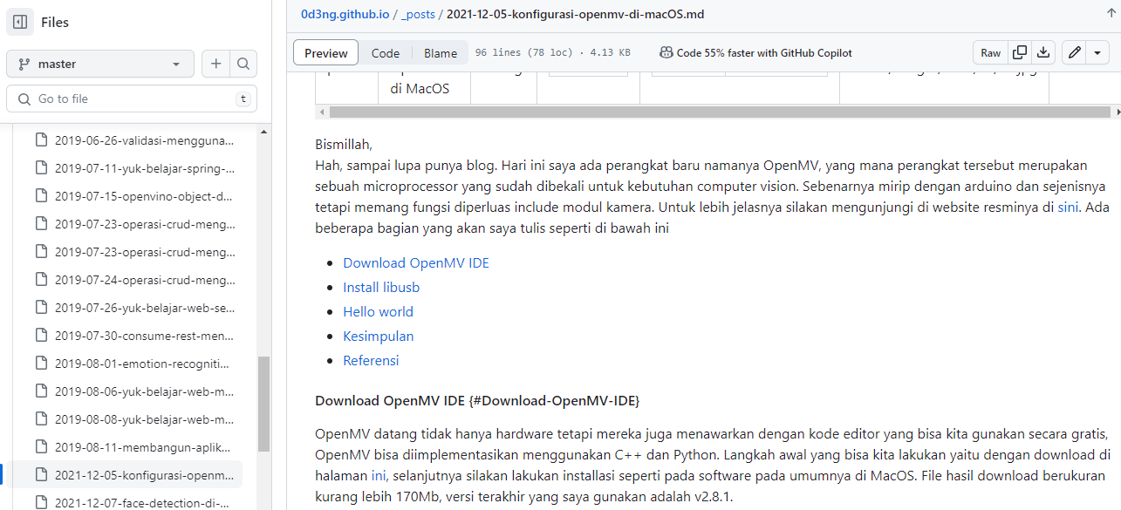
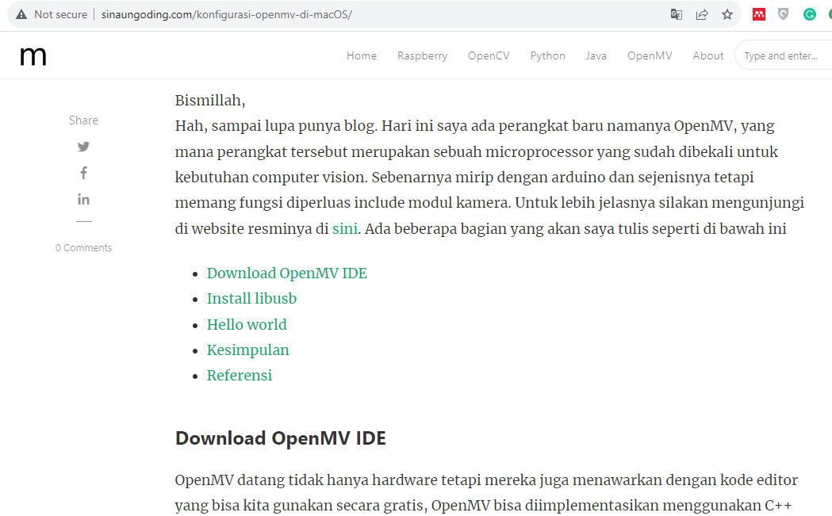
GitHub - GitHub Pages
We can create a static website for project documentation, portfolio, or personal pages on GitHub using GitHub Pages.

Slide 18
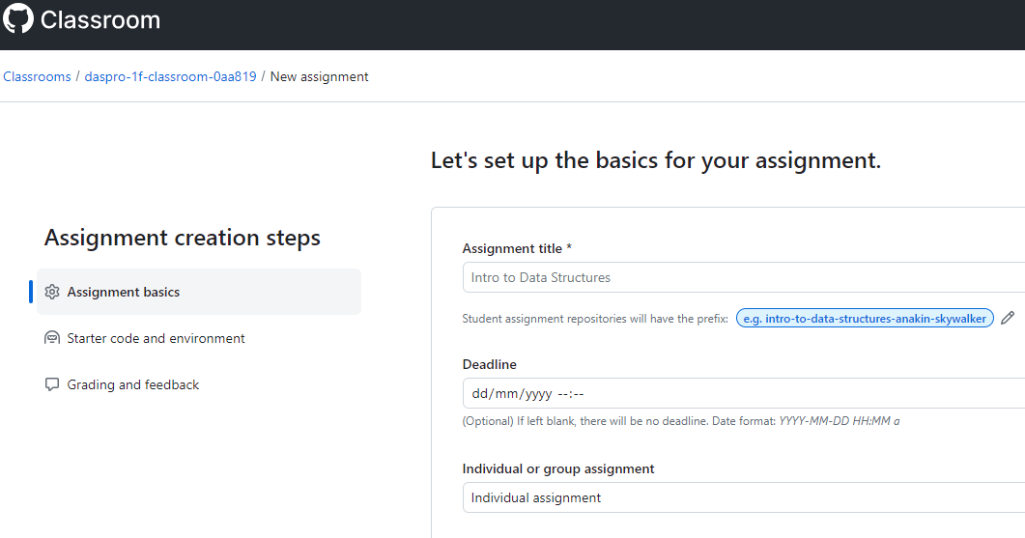
GitHub - GitHub Classroom
GitHub Classroom has functions such as the Learning Management System (LMS) to manage classes such as giving assignments, providing materials, conducting assessments, and other functions for learning.

